Slide 1




Cayucos Sustainable Water Project
June 26, 2019
David Crye
General Engineering Contractor, Inc

Slide 2
DISCUSSION TOPICS
OVERVIEW and PROGRESS UPDATE
CURRENT PROJECT STATUS
FUTURE MILESTONES
AUDIENCE QUESTIONS

Slide 3
CMB WASTEWATER TREATMENT FACILITY
CURRENT PROPOSED (DISTRICT) (MOU/COUNCIL RESOLUTION)
% OWNERSHIP
    40% LAND
    35% FACILITY AND CAPACITY
    35% TREATED EFFLUENT
  30% W/EQUITY CAPITAL COST
  50/50 VOTING
  SET BY DISTRICT RATES
  $25 M NEW FACILITY COST

Slide 4
CMB WASTEWATER TREATMENT FACILITY
CURRENT PROPOSED (DISTRICT) (MOU/COUNCIL RESOLUTION)
% OWNERSHIP
    40% LAND 100% CMB
    35% FACILITY AND CAPACITY 100% CMB
    35% TREATED EFFLUENT 100% CMB
  30% W/EQUITY CAPITAL COST 30% NO EQUITY
  50/50 VOTING NO VOTE
  SET BY DISTRICT RATES CUSTOMER – SUBJECT TO OUTSIDE USER RATE OF 120% TO 200%
  $25 M NEW FACILITY COST $166 M $124 M
  30% > $37 M

Slide 5

PROJECT FINANCING
  RURAL AREAS AND TOWNS UNDER 10,000 PEOPLE
  LONG-TERM 40 YEAR LOAN
  FIXED INTEREST RATE
  NO PREPAYMENT PENALTY

Slide 6
PROJECT FINANCING
  TOTAL LOAN = $24.3 M
  TOTAL GRANTS = $ 4.5 M

Slide 7
RATE SCHEDULE
(phased over 5 years)
Rates based on a $25 M loan
Proposed Increase Monthly Bill (per EDU)
July 2017 + $15 $ 67
July 2018 + $15 $ 82
July 2019 + $ 6 $ 88
July 2020 + $ 6 $ 94
July 2021 + $ 4 $ 98

Slide 8
CURRENT PROJECT STATUS
DAVID CRYE – Grading Contractor
  Grading Finished November 2018
CUSHMAN CONTRACTING CORPORATION
  Plant Contractor
  Construction Beginning JULY 2019
Estimated Plant Operational by DECEMBER 2020

Slide 9
FUTURE MILESTONES
Cayucos Solar Project
LS #5 Expansion
Pipeline from LS#5 to Plant
Acquisition of LS#5 Property
Acquisition of New Cayucos Owned Outfall

Slide 10
CAYUCOS SOLAR PROJECT
1.4 to 2.0 MEGAWATTS
Current peak pricing at $0.28/KWH
District will enter in to a Power Purchase Agreement to supply low cost power for 20 years at $0.12 to $0.14/KWH
No Cost to District - Construction and Financing provided by PPA in exchange for tax credits
Aggregation of all of the Districts Electric Meters
Allows the District to become Carbon Neutral

Slide 11
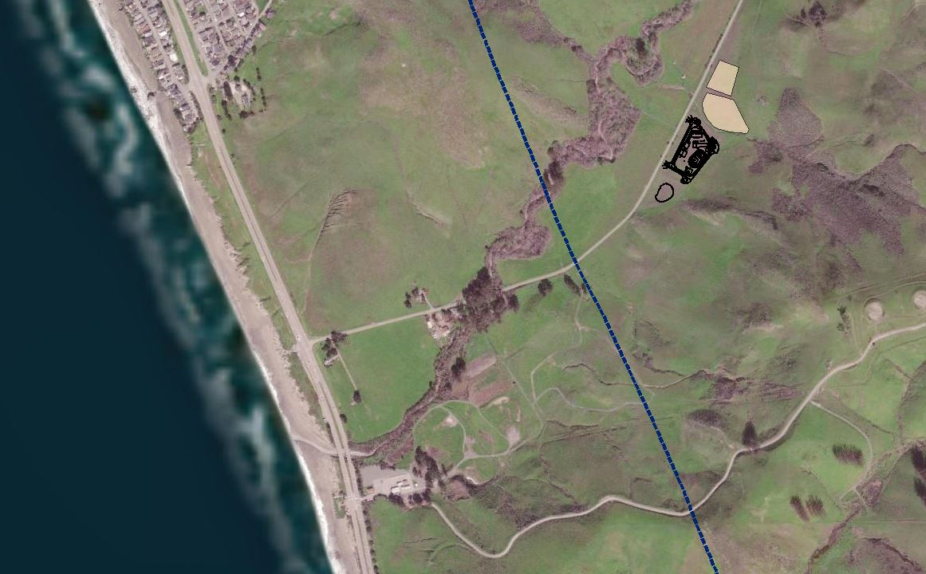

Slide 12
Lift Station 5 – Expansion and Pipeline
Expansion
  Refurbish existing 35 year old wet well
  Install second wet well and pumps
  Replace undersized generator
Pipeline
  Install two HDPE pipelines from LS #5 to CSWP Plant
  1000 feet to be directional drilled to avoid archeological artifacts

Slide 14
Acquisition of LS # 5 Property
District currently has a small lease
District will retain easements and rights for old and new facilities
District is working with Trust for Public Lands to acquire land once the District has created the Public Lots

Slide 15
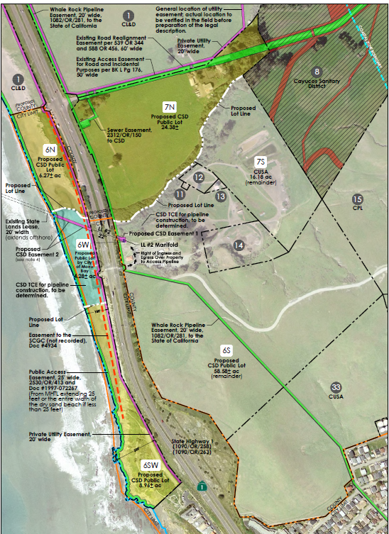

Slide 16
Acquisition of New Cayucos Outfall
Purchase Load Line #2 from Chevron
Existing 20” steel line extending 3,100 feet offshore @ 51 foot depth
District will clean the line prior to installing a 12” HDPE liner and diffuser
New Outfall will allow gravity flow from Treatment Plant…No need to pump to MB

